Slide 1
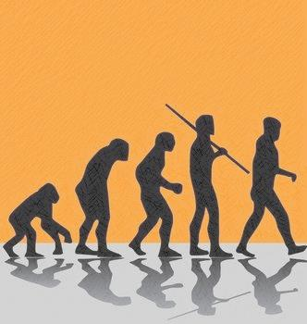
Ch 20 CULTURAL TRENDS IN EVOLUTION OF HOMININS

Slide 2
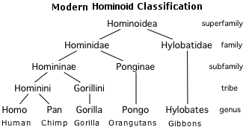
Cultural Evolution
Hominines have evolved due to the changing environment (selective pressure) to become more suited.
Culture = anything that is learned e.g. making of tools, hunting methods, food preparation, language and art use.
Improvements and increased complexity of cultural factors has lead to
cultural evolution

Slide 3
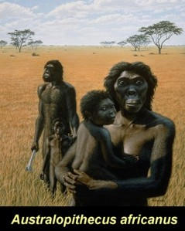
In the beginning….
Ape-like hominins lived in a woodland or forest environment, possessed features suited to aboreal life.
2.5mill years ago…
The AUSTRALOPITHECINE evolves
initially from Africa.
5-6mill years ago…
Dramatic drops in temperatures led to thinning of forests and more and more open grassland → limited availability of food (selective pressure)… Animals suited to aboreal life were not favored, however apes with limited bipedal locomotion and erect stance were favored.

Slide 4
AUSTRALOPITHECINE
LIFESTYLE CULTURE:
Developed home bases, from which hunters and foragers went out in search for food
No evidence of fire use
Simple pebbles tools enabled them to utilise resources in their environment more effectively
TOOL USE:
Pebble tools or Oldowan tools – from choppers (tennis ball size), chisels, flakes and scrapers (marble size)
Employed precision grip in order to use scrapers
…Australopithecine africanus begins its migration to Middle East and Asia in search for better environments.

Slide 5
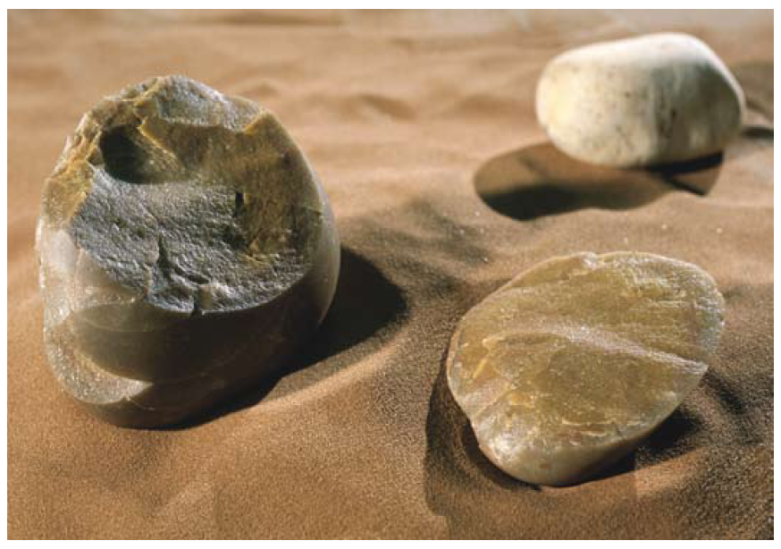

AUSTRALOPITHECINE
TOOL USE:
Stone tools with chipped flakes off rounded pebble, indicates preparation of foods i.e. cutting meat
No evidence of tool manufacture or tool culture

Slide 6
HOMO HABILIS
LIFESTYLE CULTURE:
Robust with powerful grasp suited to climbing trees… indicates able to gather food within tree’s, at night slept in trees
Had home bases where young remained.
Increased brain size indicates diet high in complex fats (high energy foods) i.e. meat more significant in diet.
Became hunters (males) not just gatherers (females), caught and killed or stole food from predators.
Were also scavengers (ate remains of prey killed by others)
Developed powers of reasoning and were cunning
Shared foods within family/group created sense of community
Development some sort of spoken language evidence by bulge in speech area of brain but no complex sounds.

Slide 7
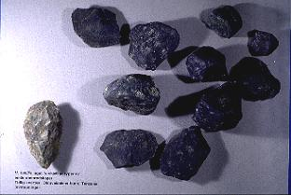
HOMO HABILIS
TOOL USE:
Stone/pebble tools with a core and flakes removed on some sides, similar to Australopithecine.
Used choppers and scrapers for cutting meat

Slide 8
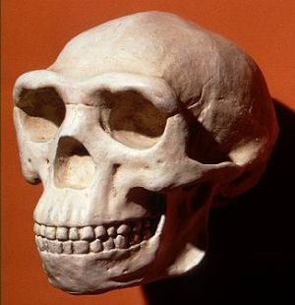
HOMO ERECTUS
LIFESTYLE CHANGES:
Able to manipulate environment to suit their needs.
Evidence of fire use for warmth, keep predators away, cooking
Built huts for shelter at home base
Had tool manufacturing sites
Men where skillful hunters (preferably deer meat) and fisherman
Hunted in groups using a wide range of techniques
Woman gatherers
Capable of logical thought and communication
Wider range of foods consumed due to fire use
Increased emphasis on care of young
More complex spoken language

Slide 9
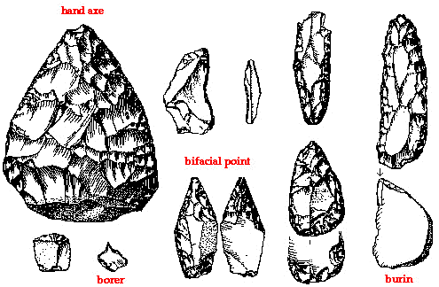
HOMO ERECTUS
TOOL USE:
Acheulian tools (like hand axe) – tools flaked all around the edges in different directions until a bi(two)-faced scraper with tear-drop shape is formed
Tools made from stone, bone or antler to remove flakes
Tools more often used → increased meat in diets
Used for killing animals, digging up plants, cutting meat, producing fire and skinning animals

Slide 10
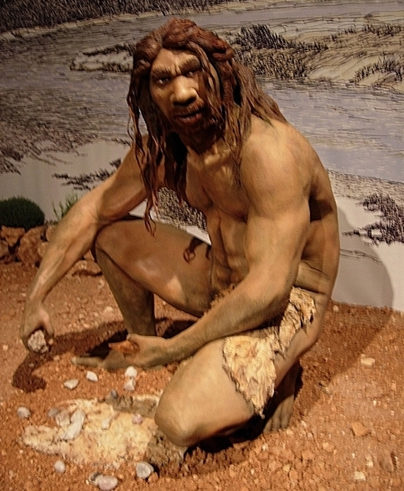
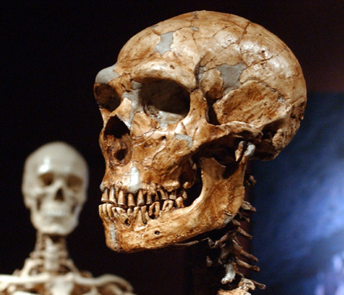
HOMO NEANDERTHALENSIS
LIFESTYLE CHANGES:
Better manipulation of environment to suit needs
Use and made own fire
Ceremonial burials their dead suggested belief in life and death
Good clothing makers
Sense of community, cared for disabled members of group
Developed a social system for sharing food and resources

Slide 11
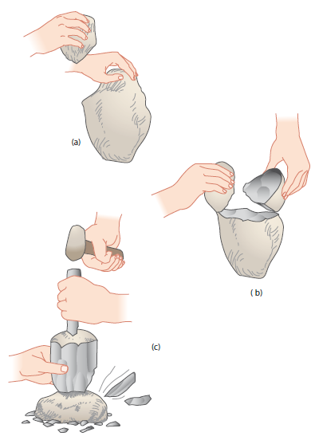
HOMO NEANDERTHALENSIS
TOOL USE:
Mousterian tools – production of stone flaked tools that were trimmed to form various cutting, scraping, piercing and gouging tools
Piece of stone made into disc-shaped core struck by another stone to produce flakes.
Made clothes from animal hides using scraping tools
Figure 19.25 The production of flake tools: (a) and (b) show preparation of the core and (c) shows how a large number of flakes can be produced

Slide 12
CRO-MAGNON (early HOMO SAPIEN)
LIFESTYLE CHANGES:
Built shelters and long houses.
Use of fire
Hunters and gatherers, relied mainly on hunting of herd animals
Huntered in large groups for large animals, mainly bison, mammoth, reindeer. Were also fishermen.
Used animal skins for shelter or clothing
Used fat from animals as oil for lamps
Bones of animals used to make tools
Evidence of rituals, burials, cannibalism, body decoration.
Developed earliest known art made from bone, ivory, horn and modelled clay; portable (moveable) or mural (attached to permanent surface) art. Line drawings.
More complex spoken language developed due to cooperative group hunting.

Slide 13
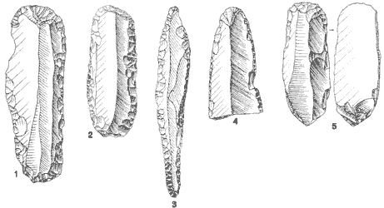
CRO-MAGNON (early HOMO SAPIEN)
TOOL CULTURE:
Many uses – fishing (fish hooks and harpoons), preparing skins for clothing, fine needles, building shelters.
Finer detail and complex designs.
Tools set into handles
Aurignacian tools (or blade tools) – stones are shaped into blades rather than flaked.
End scrapers for preparing animal skin.
Burin, a basic blade shaped
to form a sharp cutting point.
Used to cut into antler and bone

Slide 14
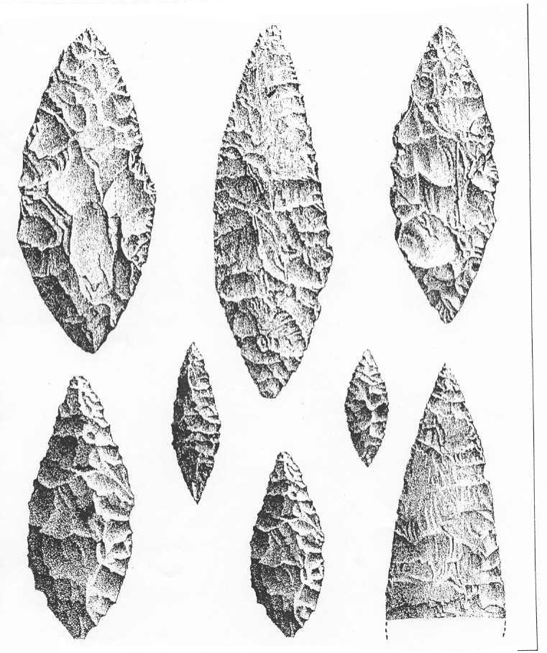
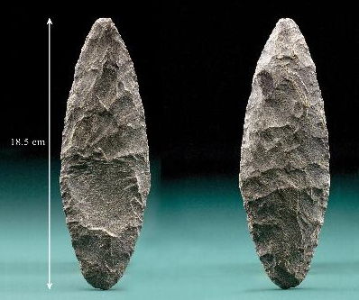
CRO-MAGNON (early HOMO SAPIEN)
TOOL CULTURE:
Solutrean tools –Made by reworking/sharpening flakes of original stone tools into willow-leaf and laurel leaf blades.
Used more so as ornaments than practically

Slide 15
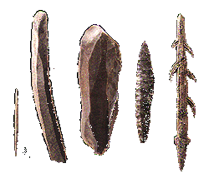
CRO-MAGNON (early HOMO SAPIEN)
TOOL CULTURE:
Magdalenian tools – bone and antler mostly, also used ivory, wood and stone.
Bone, antler and ivory tools made from burin, into fine needles, barbed spear points and spear throwers. (first to use a tool to make another.)

Slide 16
HOMO SAPIEN
LIFESTYLE CHANGES:
Able to completely modify any
environment to suit ourselves.
Able to travel easily between places
Increased life expectancy
Construction of villages

Slide 17
HOMO SAPIEN
The beginning of agriculture…
Evidenced by domestication of plants (crops) and animals
Gathering of wild forms of wheat, barley, peas, lentils (by hand or hand held flint blades)
Cross breeding of wheat to produce more fertile and stronger hybrid grains, ground and used as flour.
Domestication of animals initially sheep then pigs, goats, cattle.
Settlements able to store surplus grain food to sustain larger communities → increase birth-rate and population.
Fishing and hunting also occurred along with farming
New tools and techniques such as pottery, weaving, metallurgy

